Slide 1
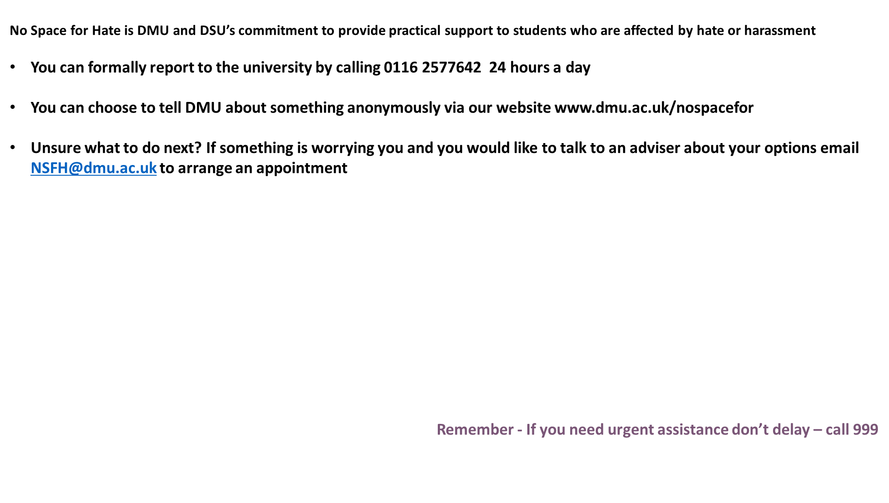

Slide 2


Slide 3

Readability: clear communication with students
Rachel Davies

Slide 4

Aims and objectives of our session (the wall of text edition):
In this staff development workshop we will explore together a range of aspects relating to readability with the overall aim of ensuring that our written communication with students is easily understood and accessible, so avoiding the difficulties, experienced by many of us at one time or another, relating to students not reading and not understanding our emails.
The key features of readable written communication will be elucidated briefly and all participants, whatever their current level of skill or knowledge, will have the opportunity to participate in practical activities, enhancing their skills and enabling them, because of course practical change is what’s required, to implement said changes to practice in their day to day working lives.

Slide 5


In this session we will:
Discuss why readability is an issue for us and our students
Identify what makes things more or less readable
Practice making some text easier to read

Slide 6
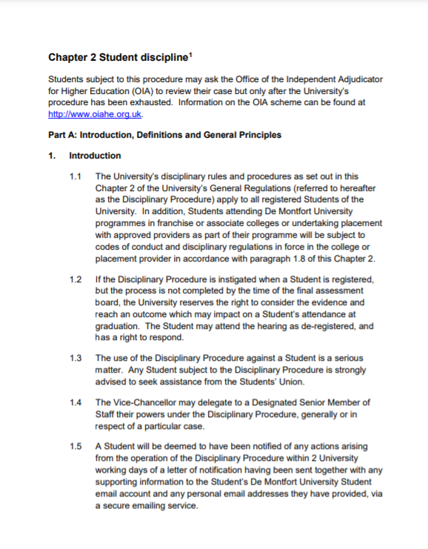

How hard to read are the General Regulations for Students?

Slide 7
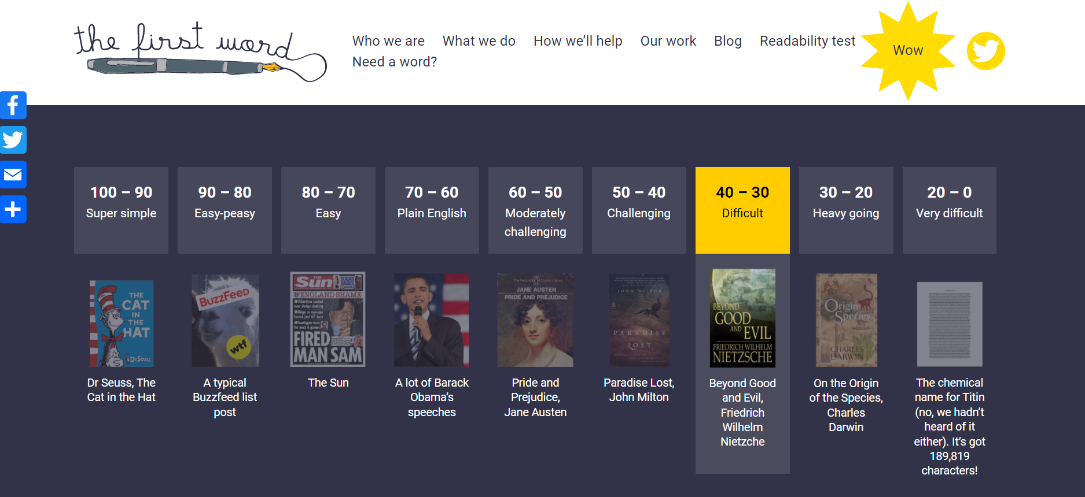
This hard!

Slide 8
Why is this important for us & our students?
Complaints
Queries, calls, problems and missed opportunities because students don’t read or don’t understand what we write
Many disabilities impact reading skills, reading speed, reading comprehension & processing of written text
International Students are unfamiliar with UK university jargon and bureaucracy. They may also be working in an unfamiliar language.

Slide 9
Timely, honest & effective communication
This is what students want from us.
They don’t feel that they always get it.
They comment on this in the NSS.

Slide 10
What makes text more or less readable? (1)
Physical/visual aspects (font, size, colour etc.)
Layout (columns, spacing, line spacing)
Long sentences
Sentences with lots of clauses (using lots of commas often indicates this kind of sentence)

Slide 11
What makes text more or less readable? (2)
Complex, multi-syllable vocabulary
Idiomatic English e.g. “raining cats and dogs”
Words that have more than one meaning e.g. “mean”
Passive voice e.g. “a decision has been made” (passive voice) vs. “we have decided” (active voice)

Slide 12

Format (the wall of text edition)
Use bullets to highlight only key info.
If you use lots of long sentences, putting them as bullet points really doesn’t help to make them more readable.
If you use lots of bullet points the effect of highlighting key information is lost.
Like I’m doing in this slide, I’ve bullet pointed each sentence, but it’s really not helping the readability, is it?
You may even have stopped reading the bullet points on this slide by now and who could blame you?

Slide 13

Format
Use headings
Use short bullet points to highlight only key info.
Bold works too.
Colour works too.

Slide 14
Disability team’s top tips:
“Bite size” blocks of text
No irrelevant or unnecessary info.
Only answer what is asked unless more detail requested.
Careful use of:
Bullets
Highlighting & colour
Spacing

Slide 15
Here’s an example of a readable email:
Hello XXXXX,
I tried to call you and have just texted you about an update on your assessment.
Please let me know when you are available for a quick phone call.
Or if you prefer to use email, please respond to let me know.
Kind regards,
XXXXX

Slide 16
Here’s another example:
Hi XXXX,
Thanks for your message. I have highlighted the things you need to do in yellow.
There is information about how to apply for an extension here: https://www.dmu.ac.uk/current-students/student-support/exams-deferrals-regulations-policies/deferral-of-assessments.aspx There is no automatic right to an extension because you have a disability I’m afraid, although we do ask academic staff to consider requests sympathetically. I would suggest that you apply for your extension on the grounds that you are waiting for your assistive technology package and so haven’t had access to the full range of support that you are entitled to yet.
Going forward, please set up regular sessions with your study skills tutor. Your DSA support is there to help you manage your time and workload more effectively. I understand why you might cancel sessions when you feel overwhelmed, but not accessing your support is likely to make the situation worse, not better.
Best wishes,
XXXX

Slide 17
Readability scoring
Reading age of text (not of the person)
Most adults can read text with reading age 11 (6th grade)

Slide 18

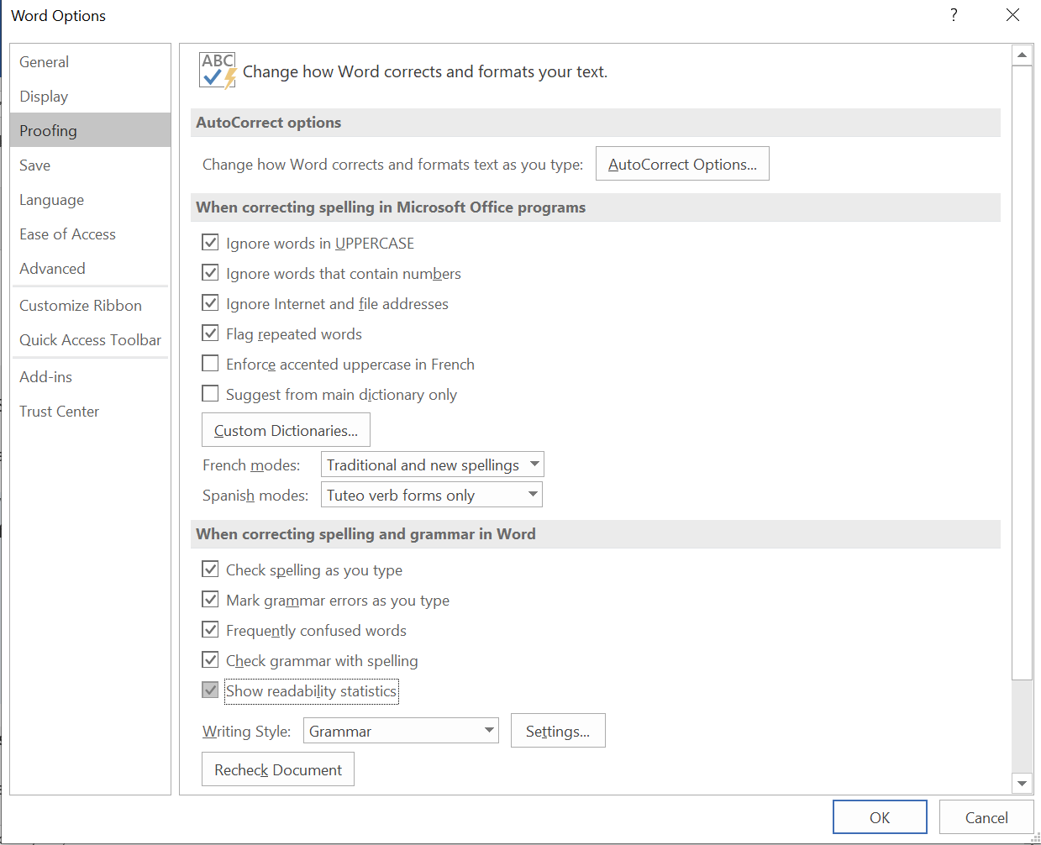

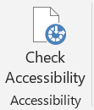

Tools to help

Slide 19
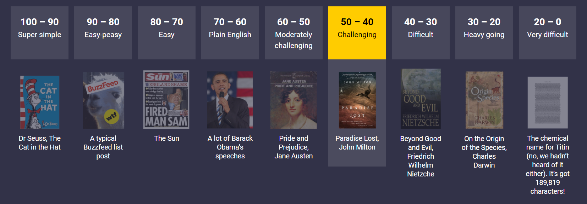
Demonstrating First Word

Slide 20
Doing it in practice
What’s the current readability?
Is any of the content non-essential? (Cut this out)
Can you say it more simply? (Rewrite this)
Can you use bold, headings or subheadings to help?
Are there too many bullet points?
Re-check the readability.

Slide 21
Time to have a go
Breakout rooms for 30 minutes
Work on editing and making clearer an example you’ve brought along
Measure the readability before and after
Report back!

Slide 22
Resources
Improving Communication- Readability.pdf (sharepoint.com)
http://www.plainenglish.co.uk/
https://support.microsoft.com/en-us/office/get-your-document-s-readability-and-level-statistics-85b4969e-e80a-4777-8dd3-f7fc3c8b3fd2
https://en.wikipedia.org/wiki/Flesch%E2%80%93Kincaid_readability_tests
Notes:
http://www.plainenglish.co.uk/ The Plain English campaign are a campaign group. They have lots of free, useful tools and information on their website.
In Microsoft Word you can calculate the readability of your document. The instructions for doing that can be found here: https://support.microsoft.com/en-us/office/get-your-document-s-readability-and-level-statistics-85b4969e-e80a-4777-8dd3-f7fc3c8b3fd2 This calculates the Flesch-Kincaid Grade and Reading Ease scores. You can find information about what those mean here: https://en.wikipedia.org/wiki/Flesch%E2%80%93Kincaid_readability_tests
ADD LINK TO TOOLKIT RESOURCE

Slide 23

www.dmu.ac.uk/decolonising
@DecolonisingDMU
#DecolonisingDMU

