Slide 2
Decolonisation and Anti-Racism in the Classroom
Hardeep Basra,
Derrick Mensah,
Kaushika Patel

Slide 3
Session Context
Decolonising DMU: building an anti-racist university
Mindset changes: disrupting/decolonising teaching and learning practices, spaces and experiences
Accessible curriculum
Students reflected in the curriculum – resources, examples, relatable content, role models
Equip ALL students with the skills to positively work in a global & diverse environment
Terminology: Black, Asian Minority Ethnic (BAME), Black, Students/People of Colour

Slide 4
Session Overview
Student Perspective: Derrick
Co-creation and change examples: Kaushika
Decolonising the PGCAP: Hardeep
Summary: Kaushika
Discussion: All

Slide 5
Student Perspective
Derrick Mensah Special Projects Officer (Student Engagemnet) and DDMU Fair Outcome Champion

Slide 6
Quotes from students:
“Fashion tutors/teacher need to familiarise themselves with black students and learn to understand us instead of giving us a 1 year ‘trial’ period- where they challenge us to see whether or not we match up to the stereotypes or not. It makes us feel like we have to work hard to be recognised as a regular student.”
“ Why are none of the officers involved in this conversation? Why were none present here?”.
“Firstly, we need to as students speak to bring members of staff at DMU into the conversation so we can discuss.”
“Faculties need to decolonise the reading list”.
“People not sitting together at university in lecture is not a university problem it is a society issue.”
“ Bring people who can actually make a change into the conversation.”

Slide 7
What are the causes?
Exclusion from Student Network
Disconnectedness in the Class
Missing out on opportunities/ Student Chats/ Key information
Unheard voices

Slide 8
Students suggested that conversations about race and racism should not be optional but a compulsory part of each students university experience.
Student expressed that the tokenism approach used by COMMs breeds mistrust rather than fosters a sense of belonging for projects such as DDMU. Student want to see realist images and communications that reflect they're real experiences.
Students also questioned where the DDMU staff were (we had to apologise and explain that this was our decision and they did understand our reasoning). They also wanted VCs, Deans and lecturers to be in the room and hear their experiences.

Slide 9
What does Decolonising DMU look like for students ?
Raising awareness: through partnership with DSU, existing student channels, societies and MarComms
Creating spaces that drive the conversation
Student-led events/activities
Engagement with society champions
Training

Slide 10
Co-creation and Change Examples
Kaushika Patel: Project Director DDMU

Slide 11
Issues in Decolonising
Institutional: cultures; management structures; governance; internal regulation and performance management; policies; and procedures.
Staff-related: workloads; curriculum design, delivery and assessment; management and delivery of research and public engagement; approaches to professional development; the regulation of relationships; and, the role of professional services’ staff in the design and delivery of services?
Student-related: co-production/co-creation of the curriculum; engagement with student support services; volunteering and public engagement; the role of students’ unions and societies; and relationships developed on-campus.

Slide 12
Co-creation
“The aim is to ensure that every student at DMU can achieve their potential and can see themselves and people like them reflected in the course(s) they study.”

Slide 13
Co-creation
Co-creation events held for students and staff to consider how we work together
Together staff and students suggested ideas and actions
Over 140 staff and students attended 2 sessions held in January/February 2018
Identified 6 key themes which attendees considered essential

Slide 14
Co-creation

Slide 15
Programme level Co-creation
Teaching and Learning: Cultural examples in teaching and culturally diverse learning resources
Development: Culturally relevant support, academic skills
Relationships: Role models, improved communication. Student integration
Community: Importance of belonging, cultural inclusivity, campus development, student societies

Slide 16
Curriculum activity
Thinking about relationships, personal development, community, and teaching and learning, what might decolonisation look like in your own practice?
What things might you/your teams want to think about to decolonise their working practices?
What things are you/your teams already doing to try and decolonise working practices?

Slide 17
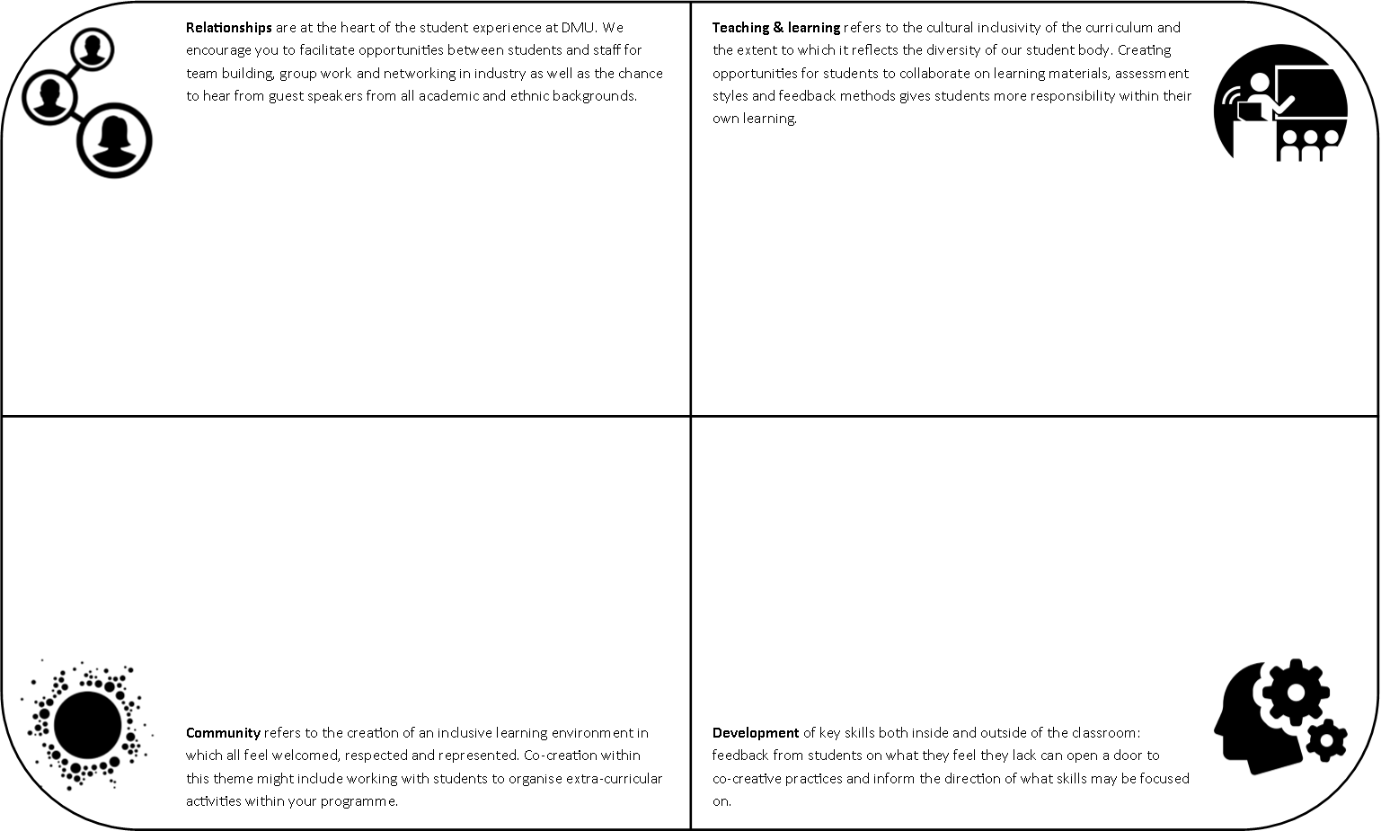
Co-creation planning

Slide 18
Co-creation planning

Slide 19
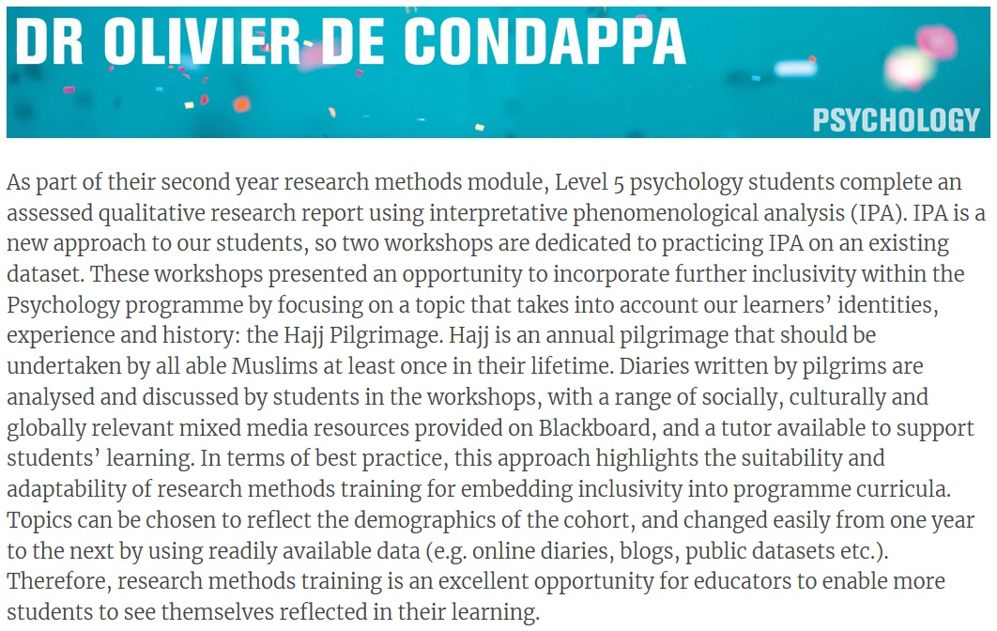

Slide 20
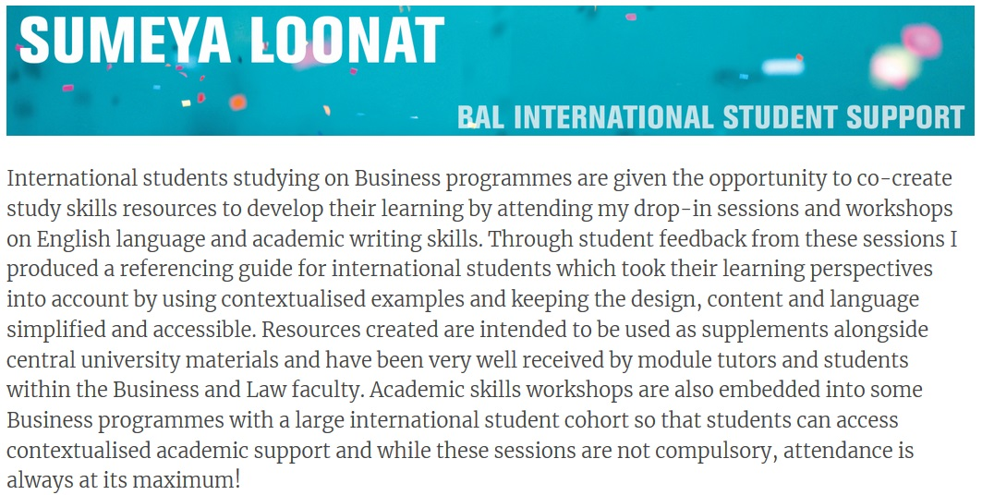

Slide 21
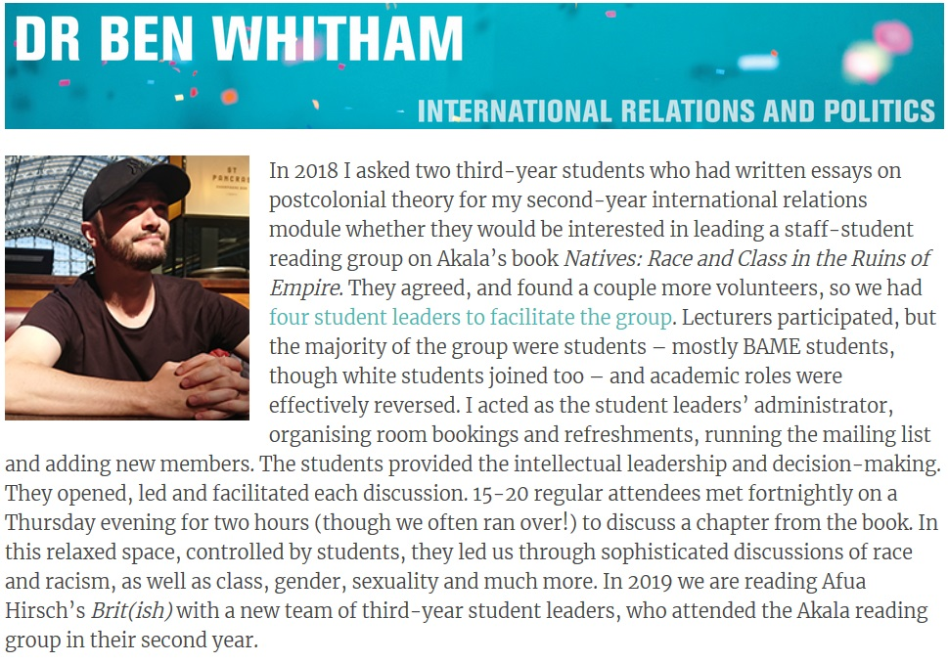

Slide 22
Library and Learning Services Resources
Some specific databases:
Black Lives matter Springer nature for researchers (collection of books and journals)
Black Freedom Struggle in the United States
History Vault, Black freedom struggle in the twentieth century
Making Open Access journals truly global
Diverse leisure reading collection with global representation offering insight into cultures and lived experiences of people from around the world.
See https://library.dmu.ac.uk/decolonisingDMU/home for the Library Decolonising DMU guide including useful resources and decolonising reading list tools

Slide 23
Decolonising the PGCAP
Hardeep Basra: Academic Development Consultant and Member of DDMU Community of Practice

Slide 24
Decolonising the PGCAP
Programme Leader for the PGCAP
hardeep.basra@dmu.ac.uk
Decolonising more than just the curriculum-we need decolonise pedagogy. We need to rethink, reframe and reconstruct the current PGCAP curriculum in order to make it better, and more inclusive.

Slide 25
Decolonising the PGCAP
Recognising that more needs to be done to challenge (disrupt) our pedagogic practices beyond the realms of inclusive practice.
It challenges existing scholarship of learning and teaching and pedagogic approaches claiming HEIs are reinforcing whiteness through knowledge, norms and behaviours which does not fully prepare academics to consider anti-racist practices or the impact of their teaching on diverse students.
To get new teachers in HE to conceptualise and position their teaching as truly inclusive and to consider anti-racist approaches to learning and teaching.

Slide 26
How?
Explicit embedding of the Decolonising DMU project in the PGCAP curriculum
Decolonising the curriculum (what you teach)
Decolonising learning & teaching approaches (how you teach)
Revising the reading list
Critical race theory
Critical pedagogy
Authors of the global south

Slide 27
How?
Empowering new academics to understand their teaching practice in the context of the DDMU project
Toolkit/resources
A range of activities for them to shape/rethink their practice
Action research
Case studies
We also need to look at who teaches on the PGCAP

Slide 28
Summary and Discussion

Slide 29
Dignity of difference
Diversify the syllabus, canon, curriculum, infrastructure and staff
Decentre knowledge and knowledge production away from the global North
Devalue hierarchies and revalue relationality
Disinvest from power structures that reinforce metrics, citations and rankings
Diminish some voices and opinions that have predominated, and magnify those that have been unheard

Slide 30
Questions
Discussion
Reflections

